Slide 1

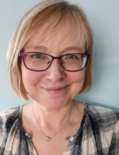
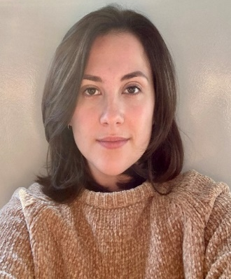
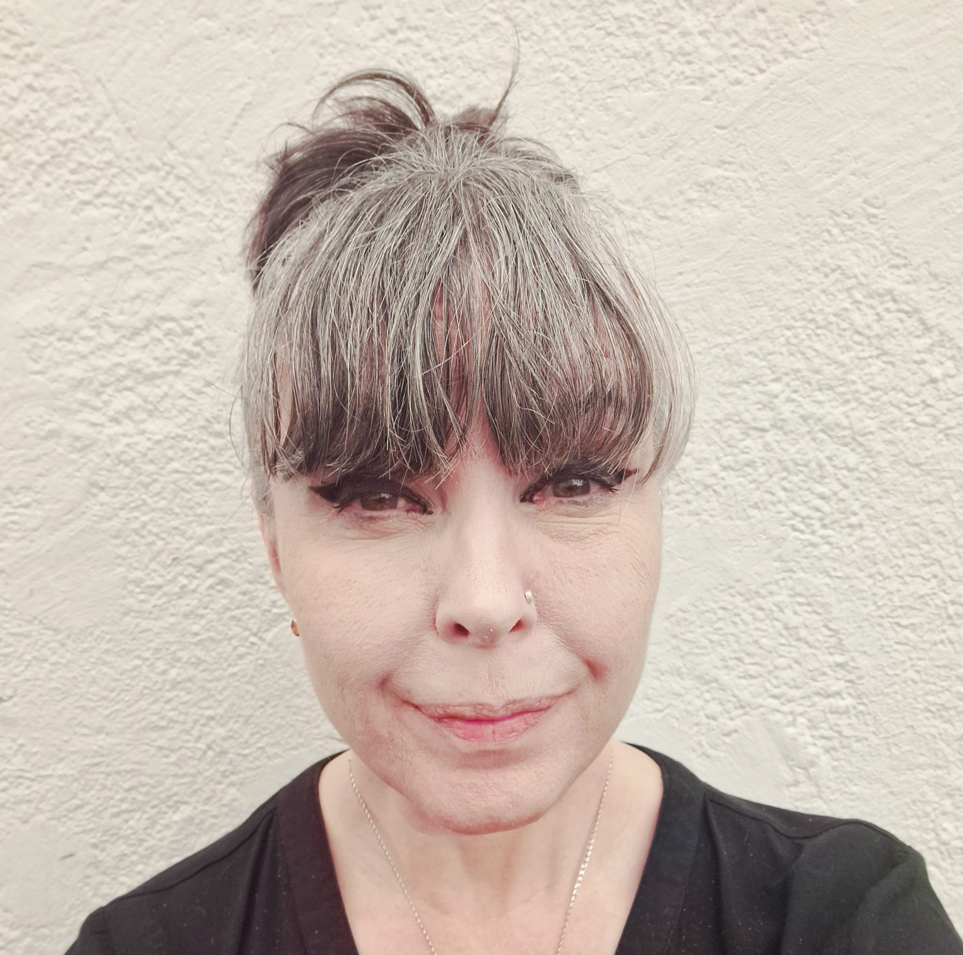
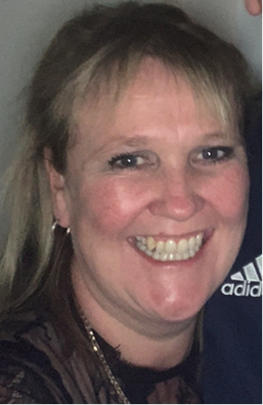
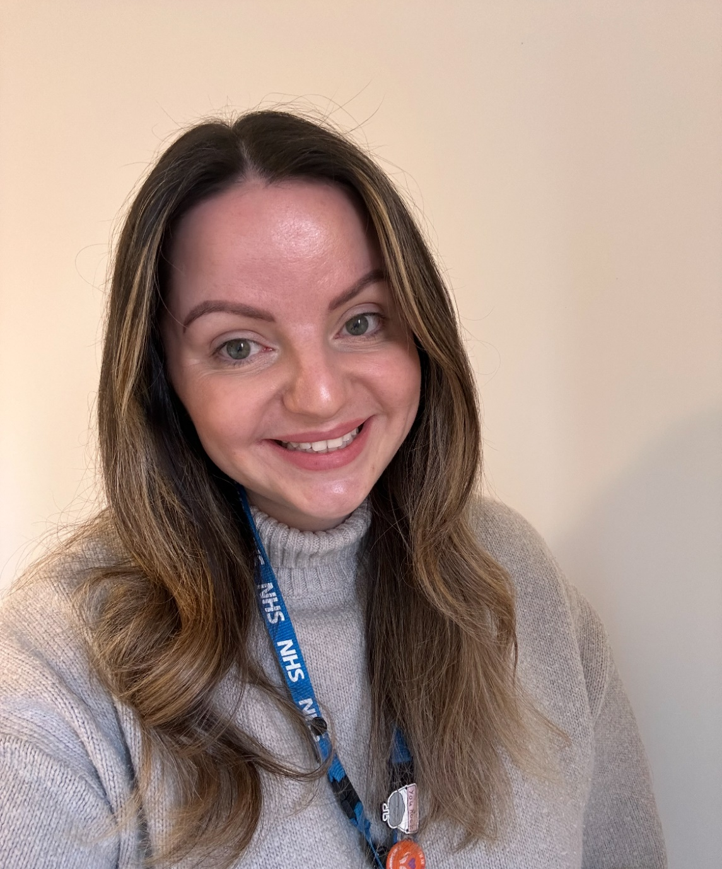
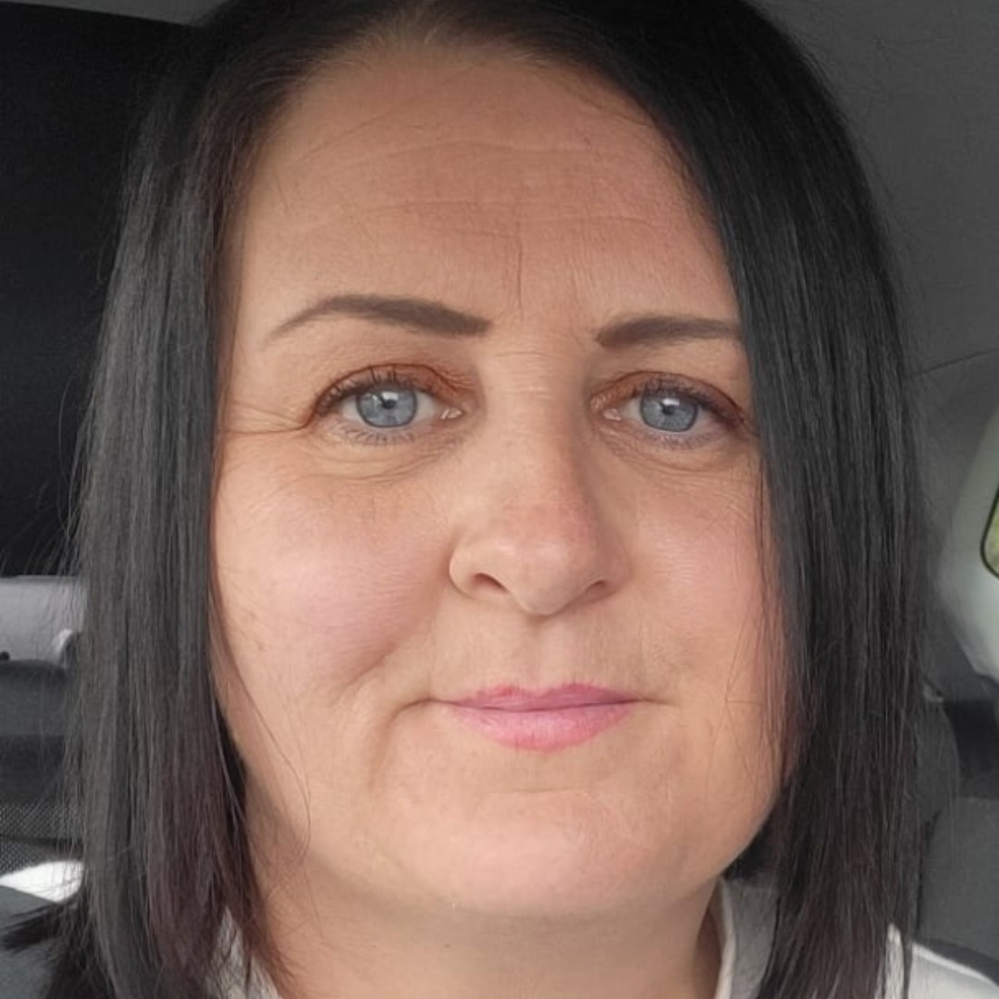

Meet the team
CORBY MENTAL HEALTH SUPPORT TEAM (MHST)
Jo
Johnson
Carrie
Sanders
Jaymee
Stanley
Kim
Esslemont
Abi
Mckim-Hay
Amanda
Munnelly

Slide 2

We offer support to children and young people in schools with mild to moderate mental health difficulties.
We work with individual children and young people, as well as offering classroom-based workshops around mental health and wellbeing.
We are keen to support parents to navigate the difficulties that might present when a child is struggling with their mental health.
Lastly, we offer signposting to schools and parents to other services that can offer support.
CORBY MENTAL HEALTH SUPPORT TEAM (MHST)

Slide 3

We work closely with the Mental Health Lead in each school and have regular meetings with them.
If you, as a parent/carer have any concerns about your child’s mental health and would like to enquire about support, please contact the school.
We work closely with the Mental Health Lead in each school and have regular meetings with them.
If you, as a parent/carer have any concerns about your child’s mental health and would like to enquire about support, please contact the school.
For further information please use the QR code or go to www.nhft.nhs.uk/mhst
CORBY MENTAL HEALTH SUPPORT TEAM (MHST)

